Slide 1
Twitter Application: a 3-Iteration Rapid Prototyping Project
Nathan Hammes, Yeshwanthi Pasupuleti, Geetha Satyanarayana, and Akshay Virkud
December 10th, 2014

Slide 2
Metrics - Requirements
The degree to which the requirements are assessed and given a degree of importance for the given iteration
The degree to which the requirements contain every part whose inclusion is necessitated by the parts already present
The capacity to map each detailed requirement to its relevant parts of the design and implementation
Prioritization is the degree to which the requirements are assessed and given a degree of importance for the given iteration.
Self-completeness is the degree to which the requirements contain every part whose inclusion is necessitated by the parts already present.
Traceability is the capacity to map each detailed requirement to its relevant parts of the design and implementation.

Slide 3
Metrics – Design
The coupling between classes is the number of other classes to which it is related, i.e the methods of one class use the methods or instance varioables of the other.
The degree to which the design has to change when the requirements change.
The degree with which the code can be reused for the future development of the other software’s or applications with minimum effort of changes in the code
Coupling is the number of other classes to which a class is “related”, i.e the methods of one class use the methods or instance variables of the other.
Flexibility is the degree to which the design has to change when the requirements change.
Reusability is the degree with which the code can be reused for the future development of the other software or applications with minimum effort to change the code.

Slide 4
Metrics - Implementation
Understandability of an implementation exists when its purpose is clear to the inspector. This implies that variable names or symbols are used consistently, modules of code are self-descriptive, and the control structure is simple or in accordance with a prescribed standard.
Robustness is the extent to which it handles anomalous input (i.e. input whose form or content is unexpected).
Security indicates the degree to which security goals are being met and drive actions taken to improve a system’s overall security program.
Code Coverage is the degree to which the test cases adequately check the code of the implementation.

Slide 5
Iterations
Initial Prototyping Phase
Feature Additions to Prototypes
Final Features Added/Live AWS deployment

Slide 6
Iteration 1 Prototypes and Requirements

Slide 7
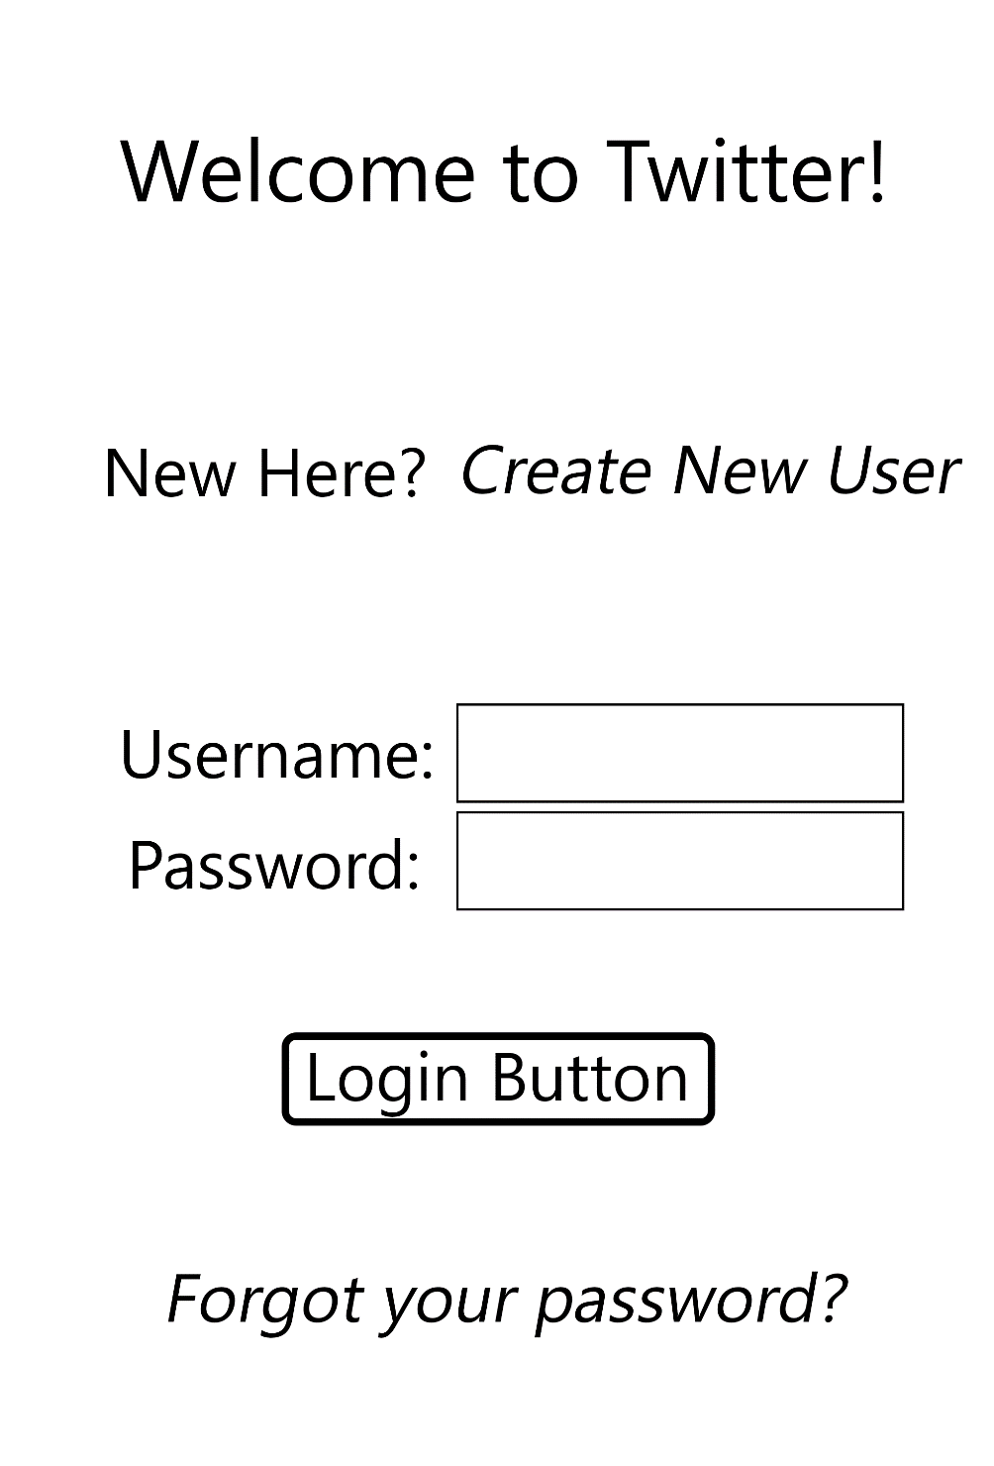
Login Page

Slide 8
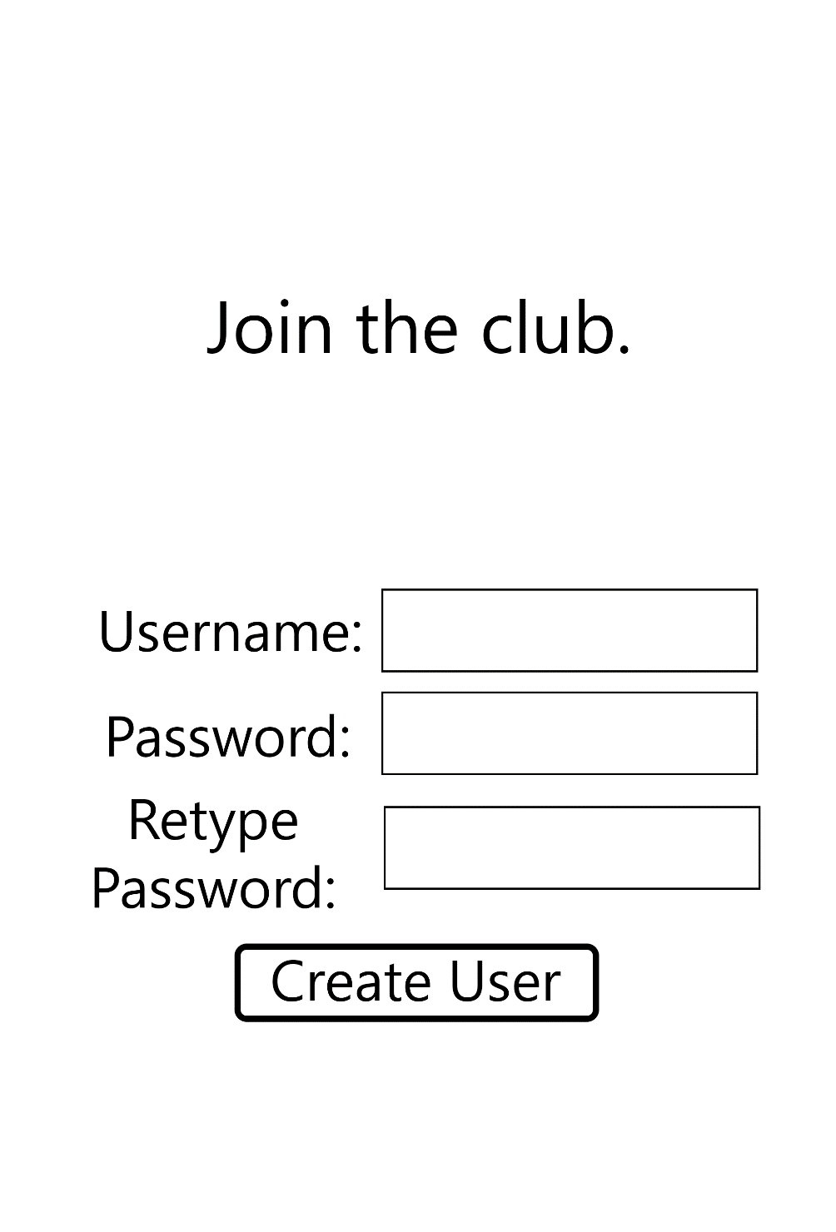
Create New User Page

Slide 9
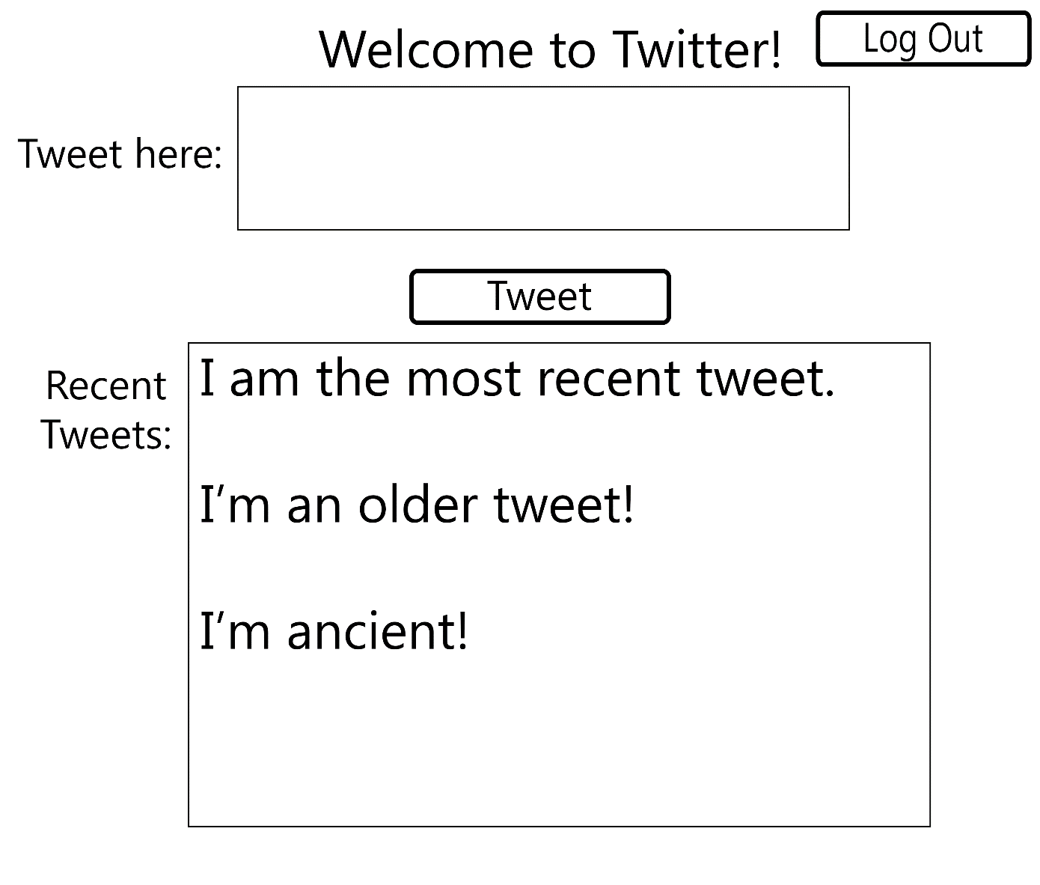
Home Page

Slide 10
Iteration 1 Design

Slide 11
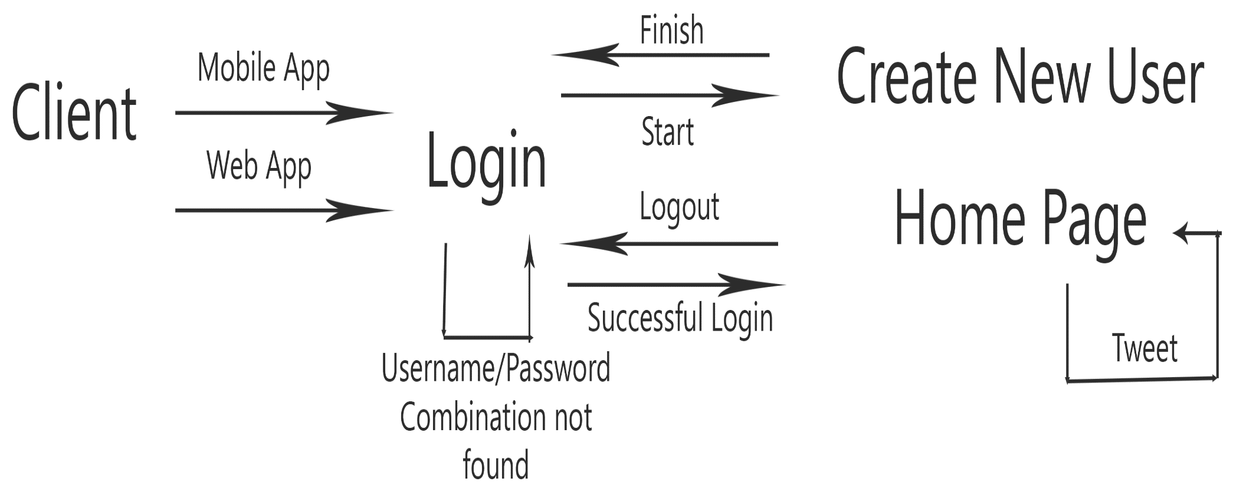
Flow Diagram

Slide 12
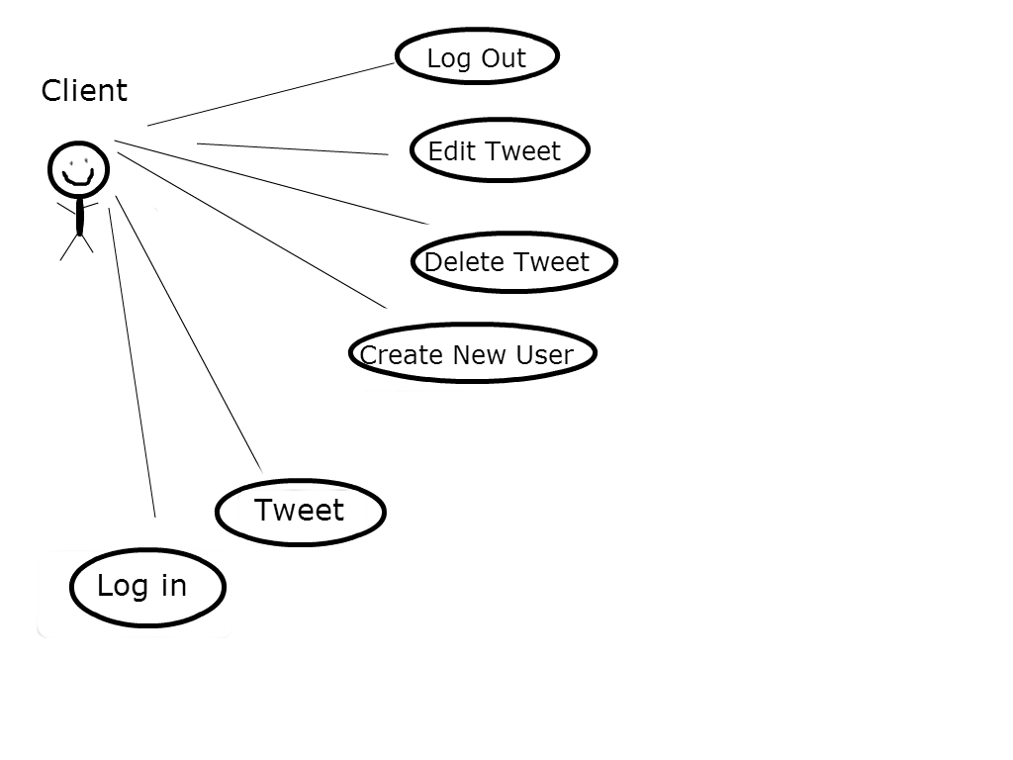
Use Case Diagram

Slide 13
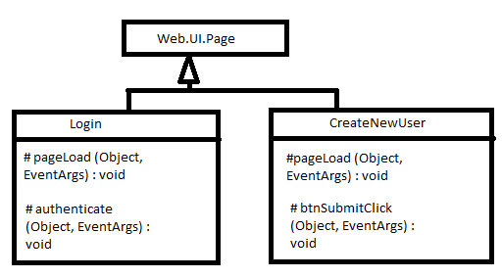
Class Diagram

Slide 14
Iteration 1 Implementation

Slide 15
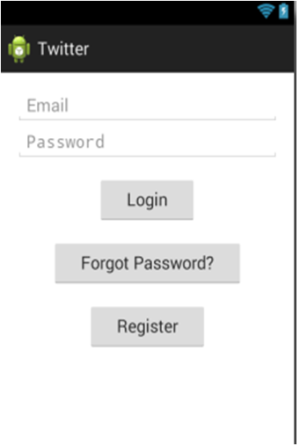
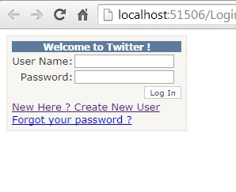
Login Page

Slide 16
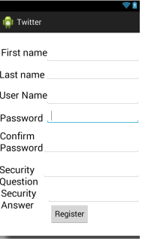
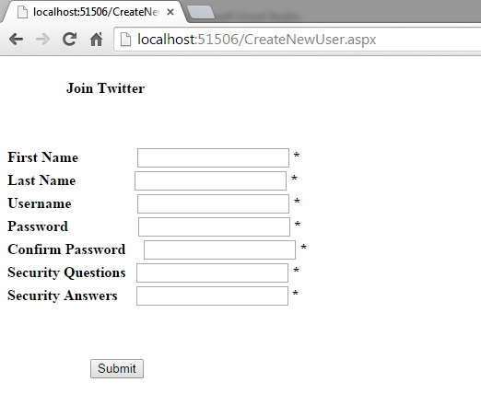
Create New User Page

Slide 17
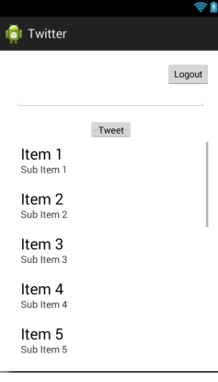
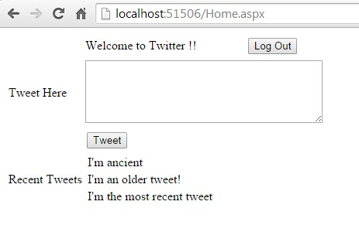
Home Page

Slide 18
Iteration 1 Difficulties
Choice of technology – Finally settled on ASP.NET and Android for the mobile app
Initial Choice of Software Development Model – Various choices, rapid prototyping seemed to match well.

Slide 19
Iteration 2 Requirements

Slide 20
Forgot/Change Password Pages, SQLite database
Forgot Password must ask for your username and directs to Change Password if username exists
Change Password Page pulls from database to check answers to a security question
Correct answer, then New Password must agree with Confirm Password Field, and added to the SQLite database
Database must store all other information as well – tweets, usernames, password, First and Last name

Slide 21
Iteration 2 Design

Slide 22
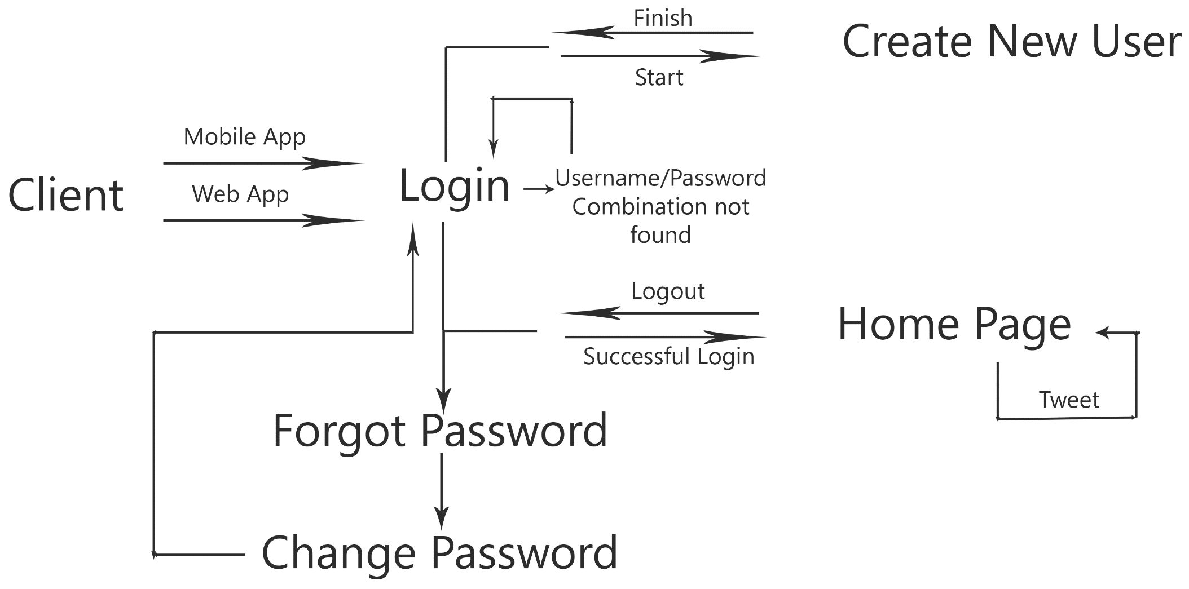
Flow Diagram

Slide 23
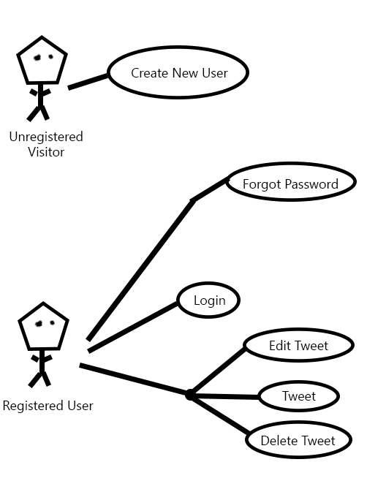
Use Case Diagram

Slide 24
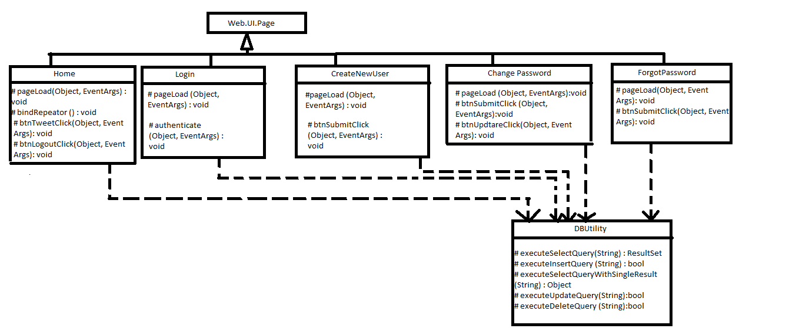
Class Diagram

Slide 25
Iteration 2 Implementation

Slide 26
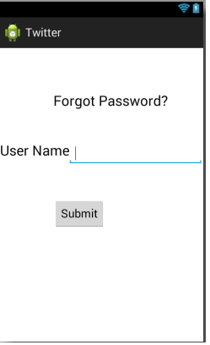
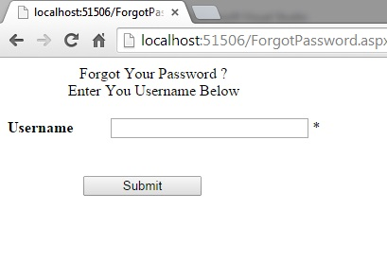
Forgot Password Page

Slide 27
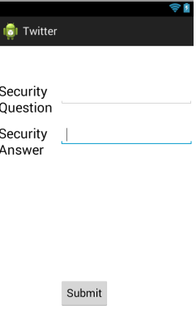
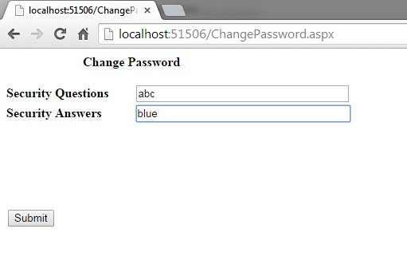
Change Password

Slide 28
Iteration 2 Difficulty
Integration of SQLite database was more difficult than expected
Needed a .NET library for database connection
Actual connection of that library to SQLite

Slide 29
A General Example of Test Case Scenarios: Forgot Password
Sr No. | Scenario | Data | Expected Result | Actual Result | Testcase - Pass/Fail
1 | User clicks the Submit button without entering any text | NA | Error: "Username is required." message is displayed. | Error Message Displayed | Pass
2 | User enters a username that does not exist in the database and clicks Submit | Username | Error: "Please provide correct username." is displayed. | Error Message Displayed | Pass
3 | User enters a username that does exist in the database and clicks Submit | Username | User redirected to Change Password page with their Security Question displayed. | Redirected Appropriately | Pass

Slide 30
A General Example of Test Case Scenarios: Change Password
Sr No. | Scenario | Data | Expected Result | Actual Result | Testcase - Pass/Fail
1 | User clicks the Submit button without entering any text | NA | Error: "Incorrect security answer" message is displayed. | Error Displayed | Pass
2 | User clicks the Submit button after entering text that is not the answer to the user's security question. | Security Answer | Error: "Incorrect security answer" message is displayed. | Error Displayed | Pass
3 | User enters the answer to their correct username and hits Submit | Security Answer | Visibility for the New Password and Confirm Password options is set to True. | Visiblity is set to true | Pass
3a | User enters nonidentical New Password and Confirm Password and clicks Update Password button | New Password, Confirm Password | Error: "Confirm Password is not equal to New Password" message is displayed. | Error Displayed | Pass
3b | User enters identical New Password and Confirm Password and clicks Update Password button | New Password, Confirm Password | Message: "Password Updated" is displayed momentarily, user redirected to Login page | Done as per the requirement | Pass
4 | Password should be displayed in special characters | Password | Special characters should appear in the password field (such as XXXX or ****) instead of original password characters. | Special Character like …… appears in the tect box | Pass
5 | "Confirm Password" field should be displayed in special characters | Confirm Password | Special characters should appear in the Confirm Password field (such as XXXX or ****) instead of original password characters. | Special Character like …… appears in the tect box | Pass

Slide 31
Iteration 3 Design and Requirements

Slide 32
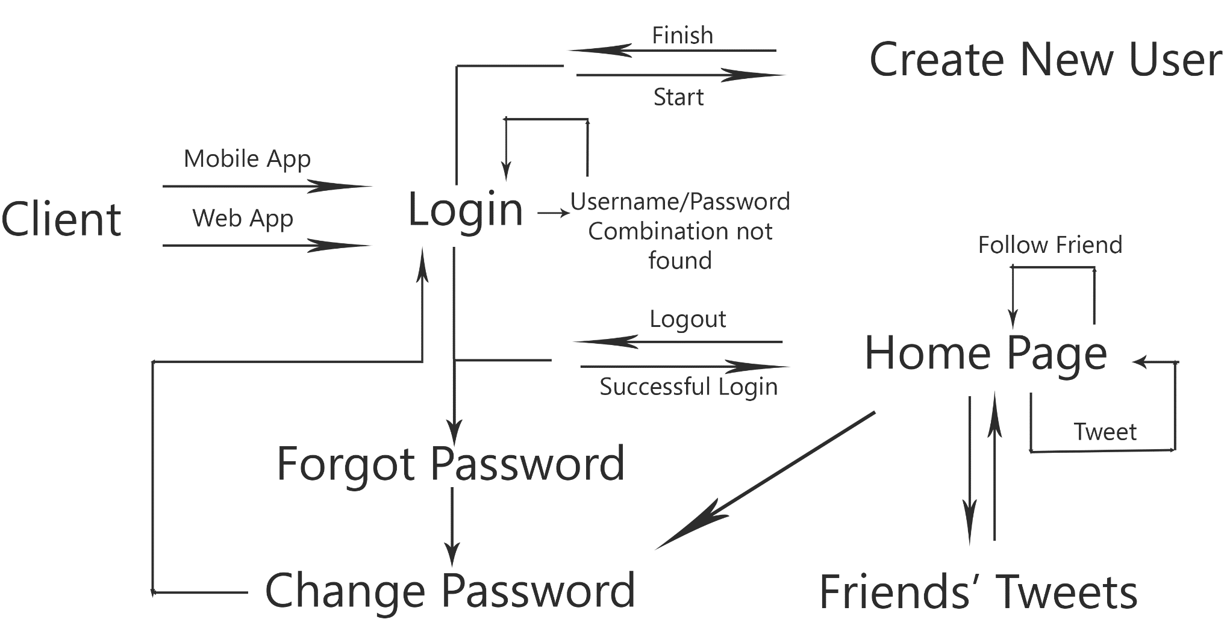
Flow Diagram

Slide 33
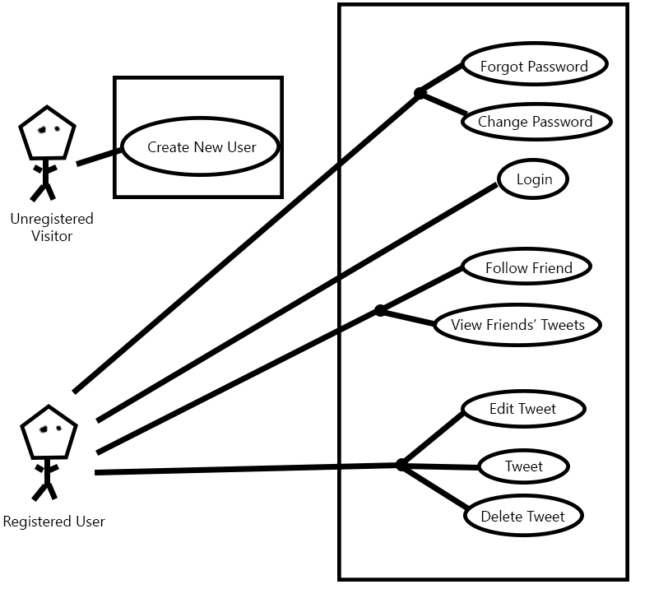
Use Case Diagram

Slide 34
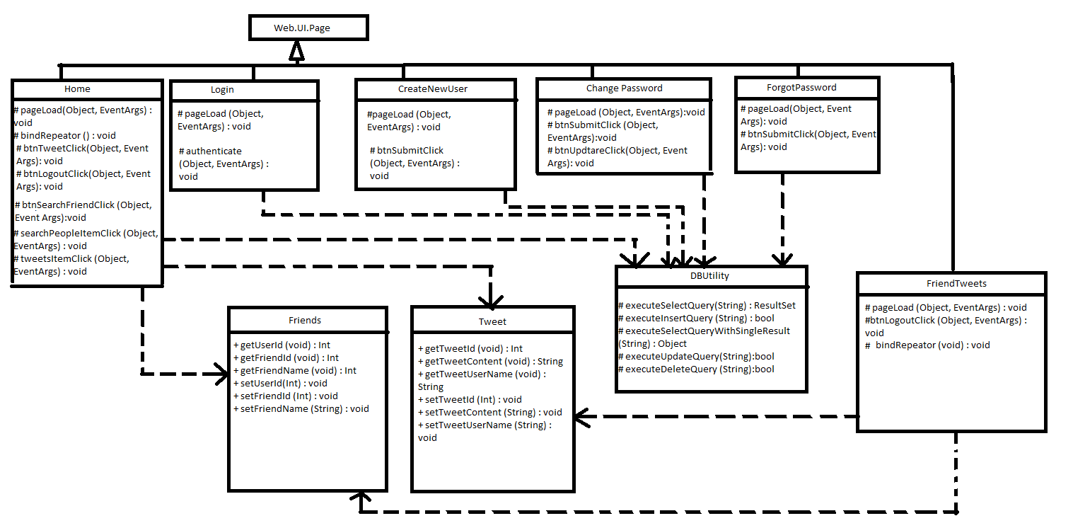

Slide 35
Iteration 3 Implementation

Slide 36
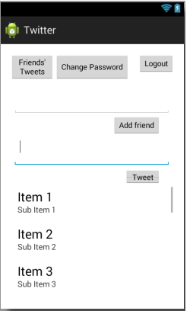
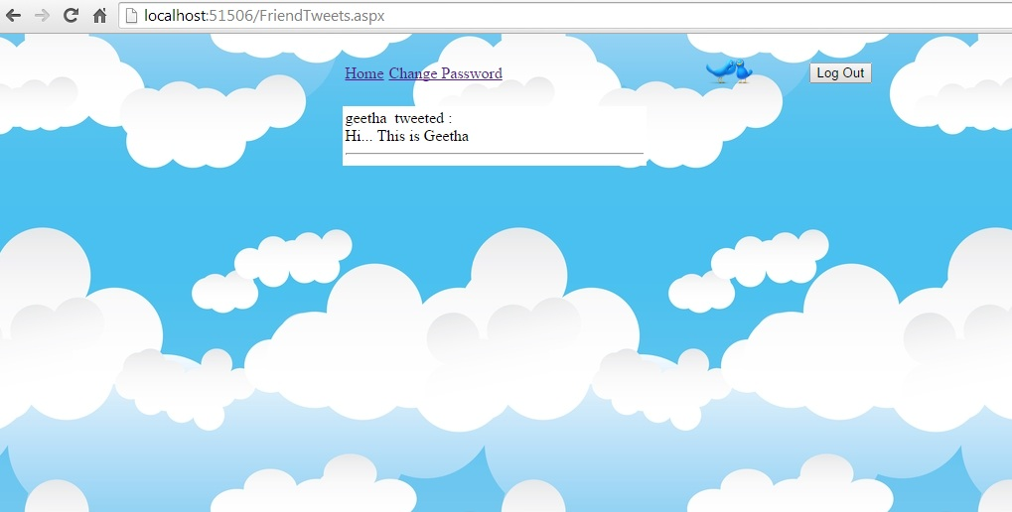
Friends’ Tweets Page

Slide 37
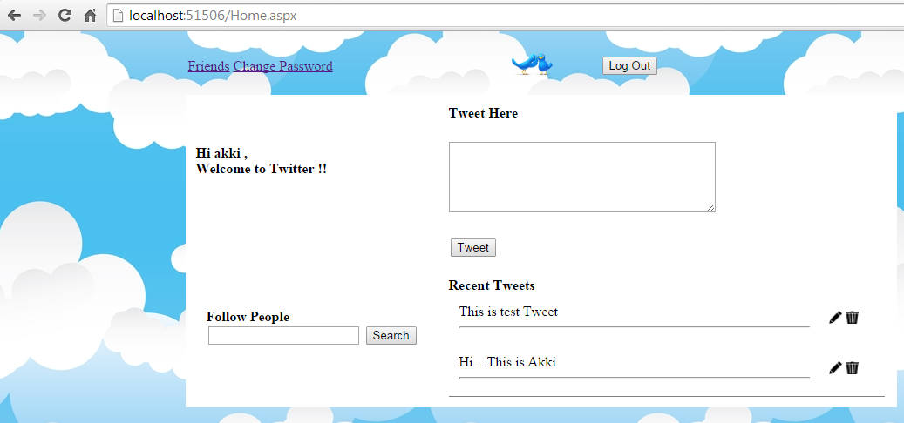
Home Page

Slide 38
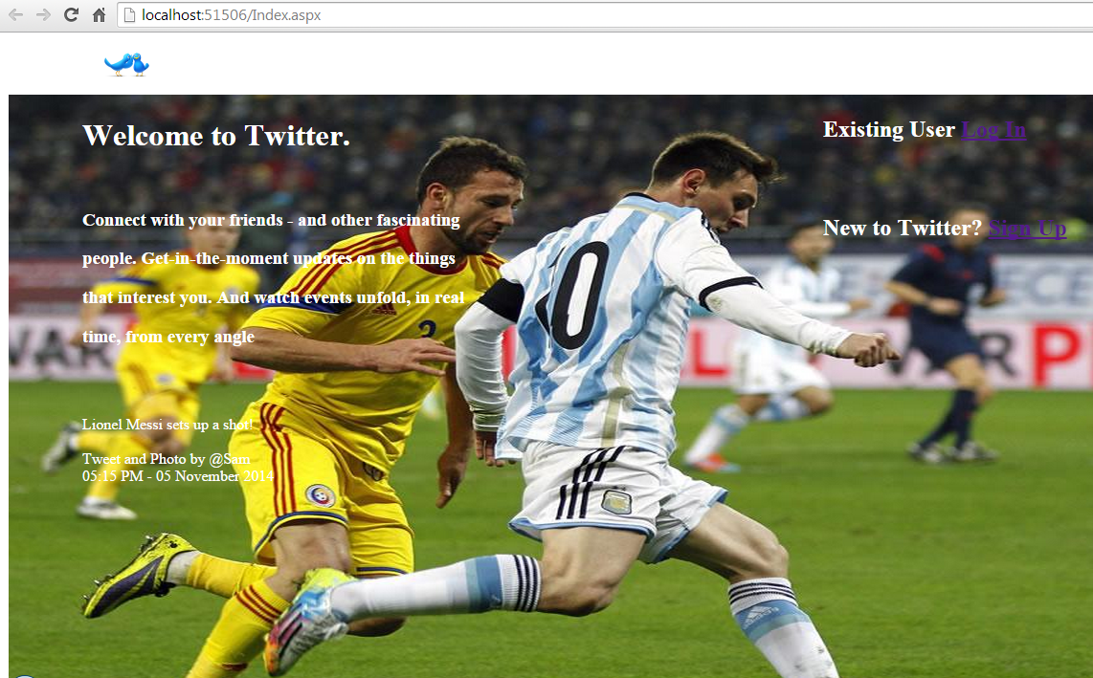
Index/Login Page

Slide 39
Requirements Metrics and Trends
Prioritization – 0, 0.67, 0.67 (10, 9, and 12 total)
Self-completeness - 1, 0.78 (Tweet Button issues), 1
Traceability - .85, .78, .67 (More aggressive with prioritization and requirements)

Slide 40
Design Metrics and Trends
Coupling – 0, 0.16, 0.3
Flexibility – 1, .8, .8
Reusability – 5.5, 4, 4

Slide 41
Reusability
Definition | The degree with which the code can be reused for the future development of the other software’s or applications with minimum effort of changes in the code
Metric Evaluation | Degree of Coverage 0 -2, Degree of Content 0-2, Parametric Coverage 0-2.
Degree of Coverage | Create New User | Login | Home | Change Password | Frogot Password | Friends Tweet
0 - Negligible covergae | NA | NA | NA | NA | NA | NA
1- May or many not be covered | NA | NA | Can be used with few changes | Can be used with few changed | Can be used with few changes | NA
2- Completely Used or covered | Few of the clasess can be covered for other applications in future projects | Few of the clasess can be covered for other applications in future projects | NA | NA | NA | Can be used
Degree of Content
0- Negligible Content | NA | NA | NA | NA | NA | NA
1- May or may not have negligible content | Specific Content can be covered completely | NA | Content could be used with changes | Could be used with slight changes | Could be used with slight changes | Could be used with changes
2- Covered content completely | NA | Specific Content could be used | NA | NA | NA | NA
Degree of Parametrization
0- Less scope of having methods | NA | NA | NA | NA | NA | Na
1- May or many not have methods | NA | NA | NA | NA | NA | Could be used
2- Widely applicable methods | All methods can be used as expected | Methods can be used as per expected names | Methods can be used as per expected names | Methods can be used as per expected names | Methods can be used as per expected names | NA
Overall Rating | 5 | 6 | 4 | 4 | 4 | 4

Slide 42
Implementation Metrics and Trends
Understandability
Robustness
Security
Code Coverage

Slide 43
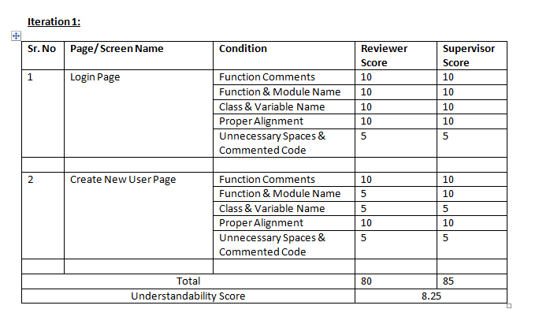
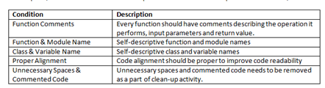
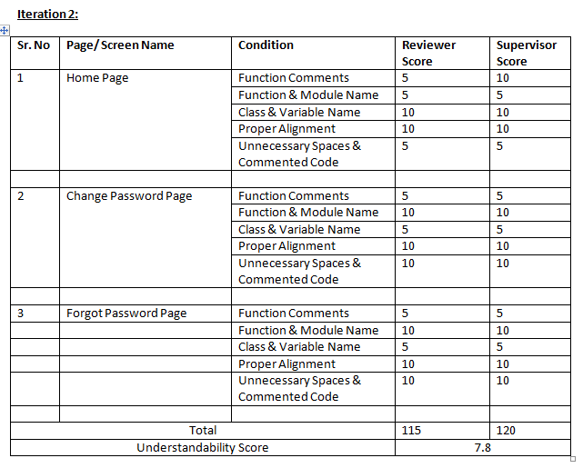
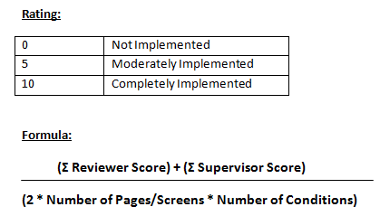
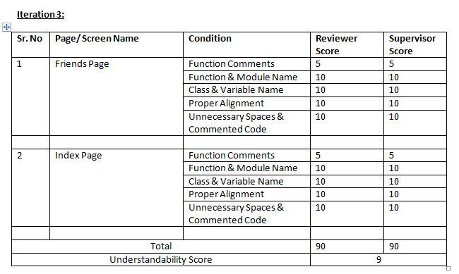
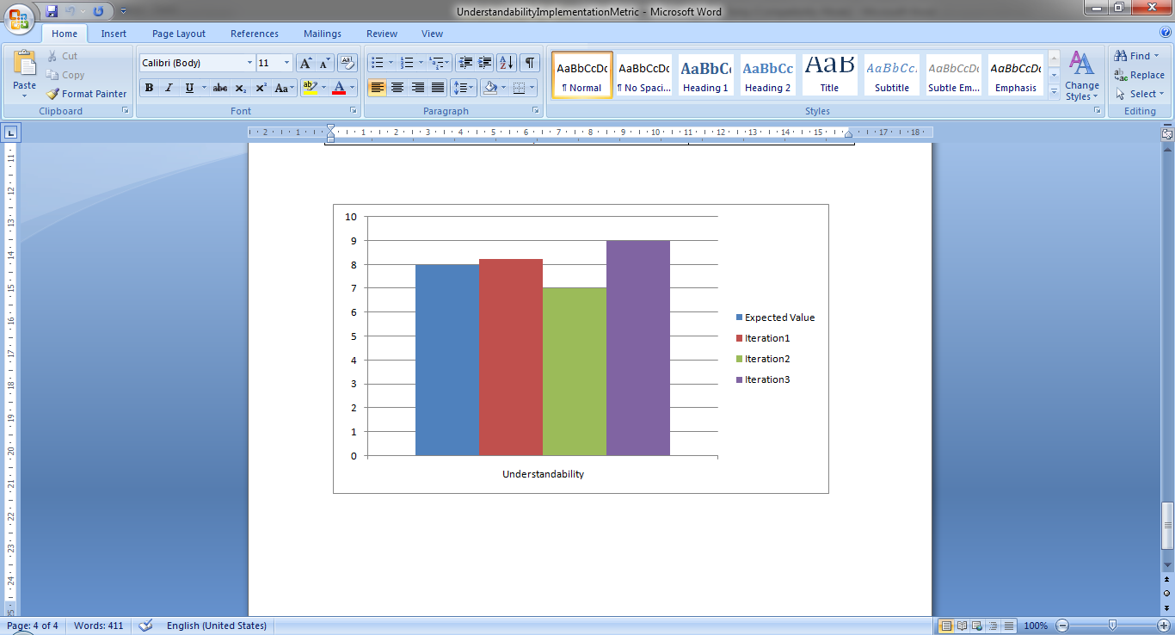
Understandability

Slide 44
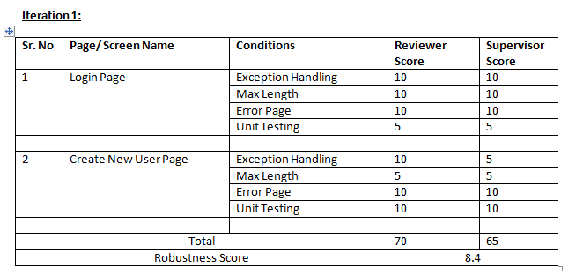
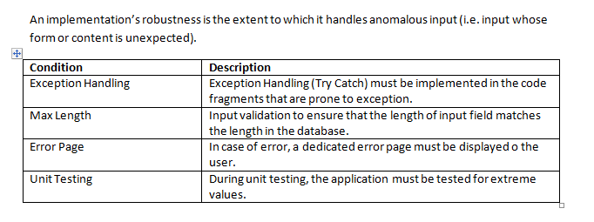
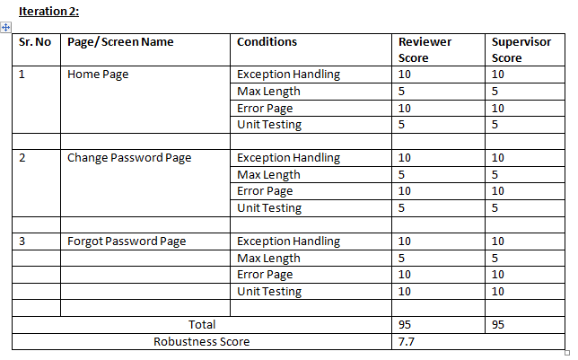
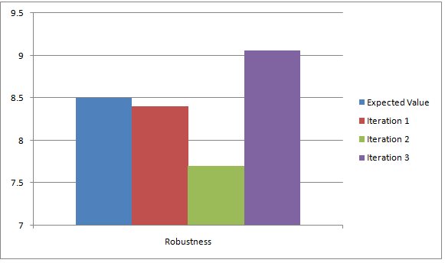
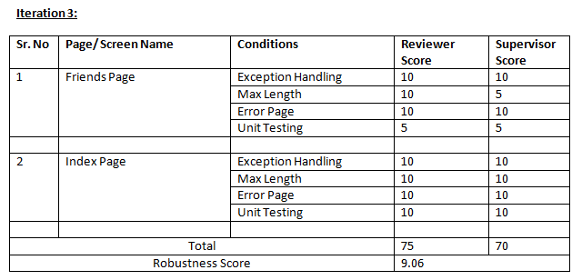
Robustness

Slide 45
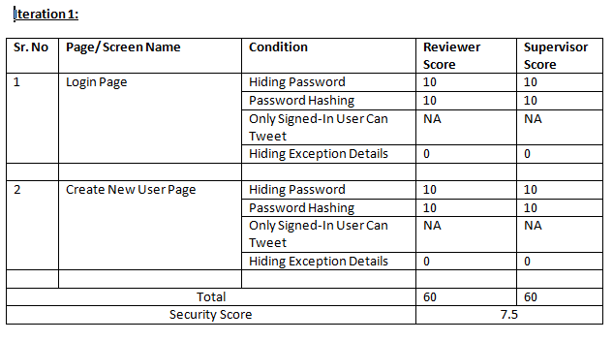
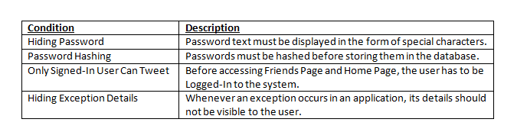
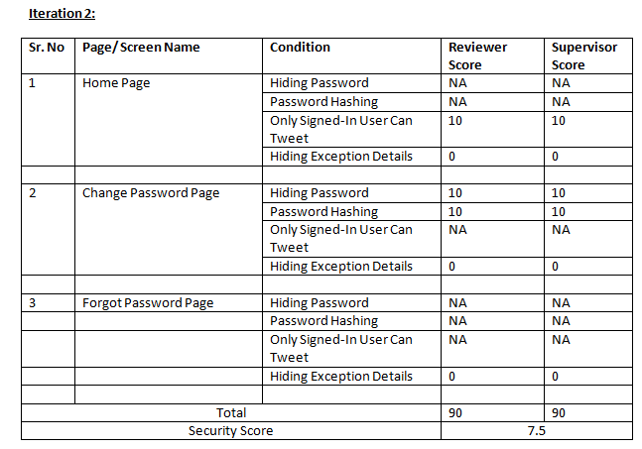
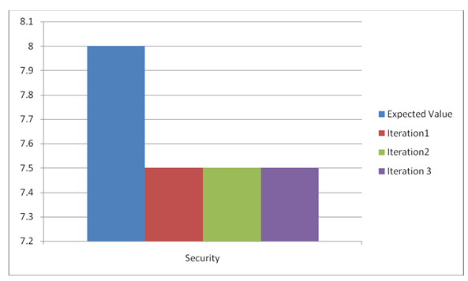
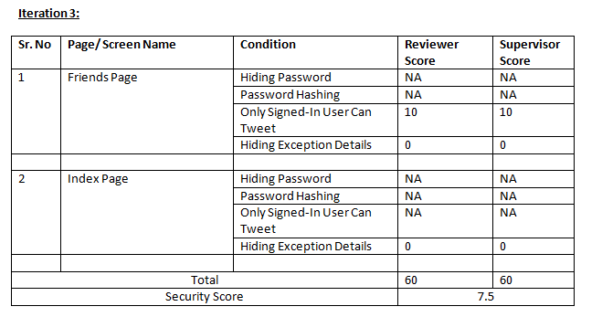
Security
Note: For NA, the rating is considered as 10

Slide 46
Code Coverage
Metric Evaluation | The code coverage tracking is done on few basic important criteria on the scale of 5. Criteria: Functional, Statement, Condition Coverage.
 |  | Create New User | Login | Home Page | Change Password | Frogot Password | Friends Tweets
 |  | Based on the code analysis and test scenarios following metrics have been tracked
 | Function Coverage | Covered | Covered | Covered | Covered | Covered | Covered
 | Statement Coverage | Covered | Covered | Covered | Covered | Covered | Covered
 | Condition Coverage | Covered | Covered | Covered | Covered | Covered | Covered
 | Overall Rating | 5 | 5 | 5 | 5 | 5 | 5

Slide 47
3rd Iteration and Overall Difficulties
Android Deployment Difficulties
Amazon Deployment for Web App
Search Friend Functionality

Slide 48
Demonstration
Web Tweet
Mobile Tweet
Creating a New User
Finding Some Friends
Viewing Friends’ Tweets

